Slide 1
emotion
By: Nicole Phillips

Slide 2
Learning objectives
Identify and describe the roles of parts of the brain involved in the experience of emotion and emotion regulation.
Identify symptoms of mood disorders and relate symptoms to biological abnormalities
Describe ways in which treatments for mood disorders can target biological abnormalities associated with specific symptoms.

Slide 3
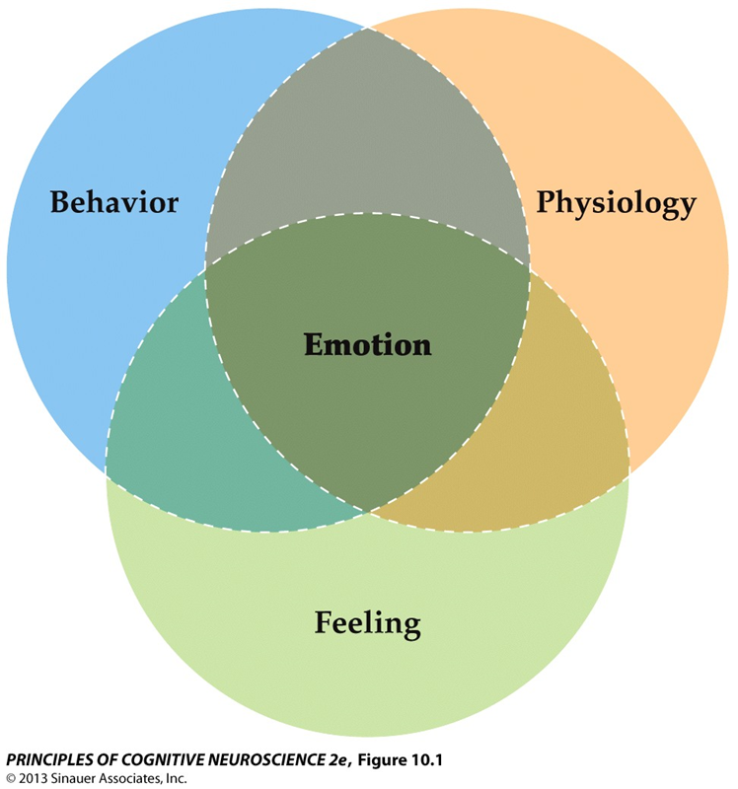
Emotions
Freezing
Running
Stance
Facial expression
Heart rate
Breathing
Blood pressure
Stress hormones
A subjective mental state that is usually accompanied by distinctive behaviors, feelings, and involuntary physiological changes.
Subjective feeling/context

Slide 4
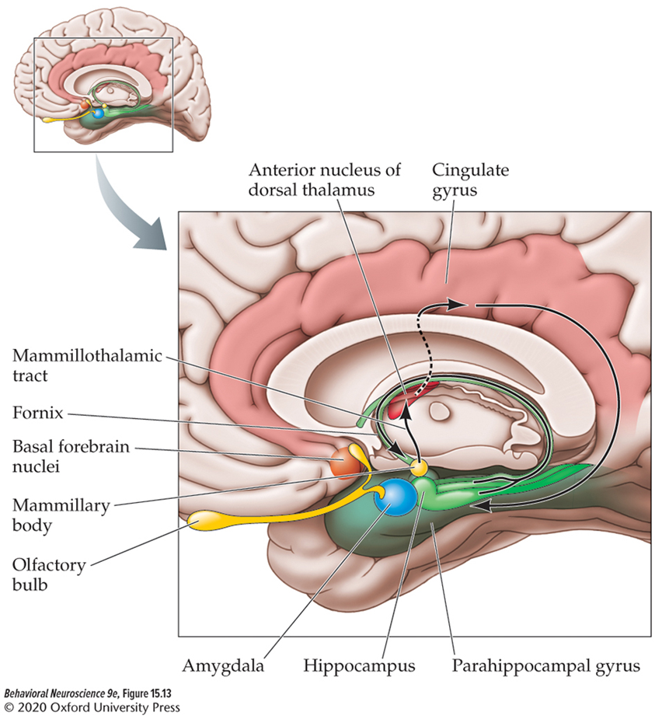
Damage to the brain reveals a role For the limbic system in emotion
Papez consolidated research on emotion and brain damage and identified:
  the mammillary bodies
  Anterior thalamus
  Cingulate cortex
  Hippocampus
  Fornix
MacLean later added the amygdala and basal forebrain nucleus and renamed the structures collectively as the limbic system!

Slide 5
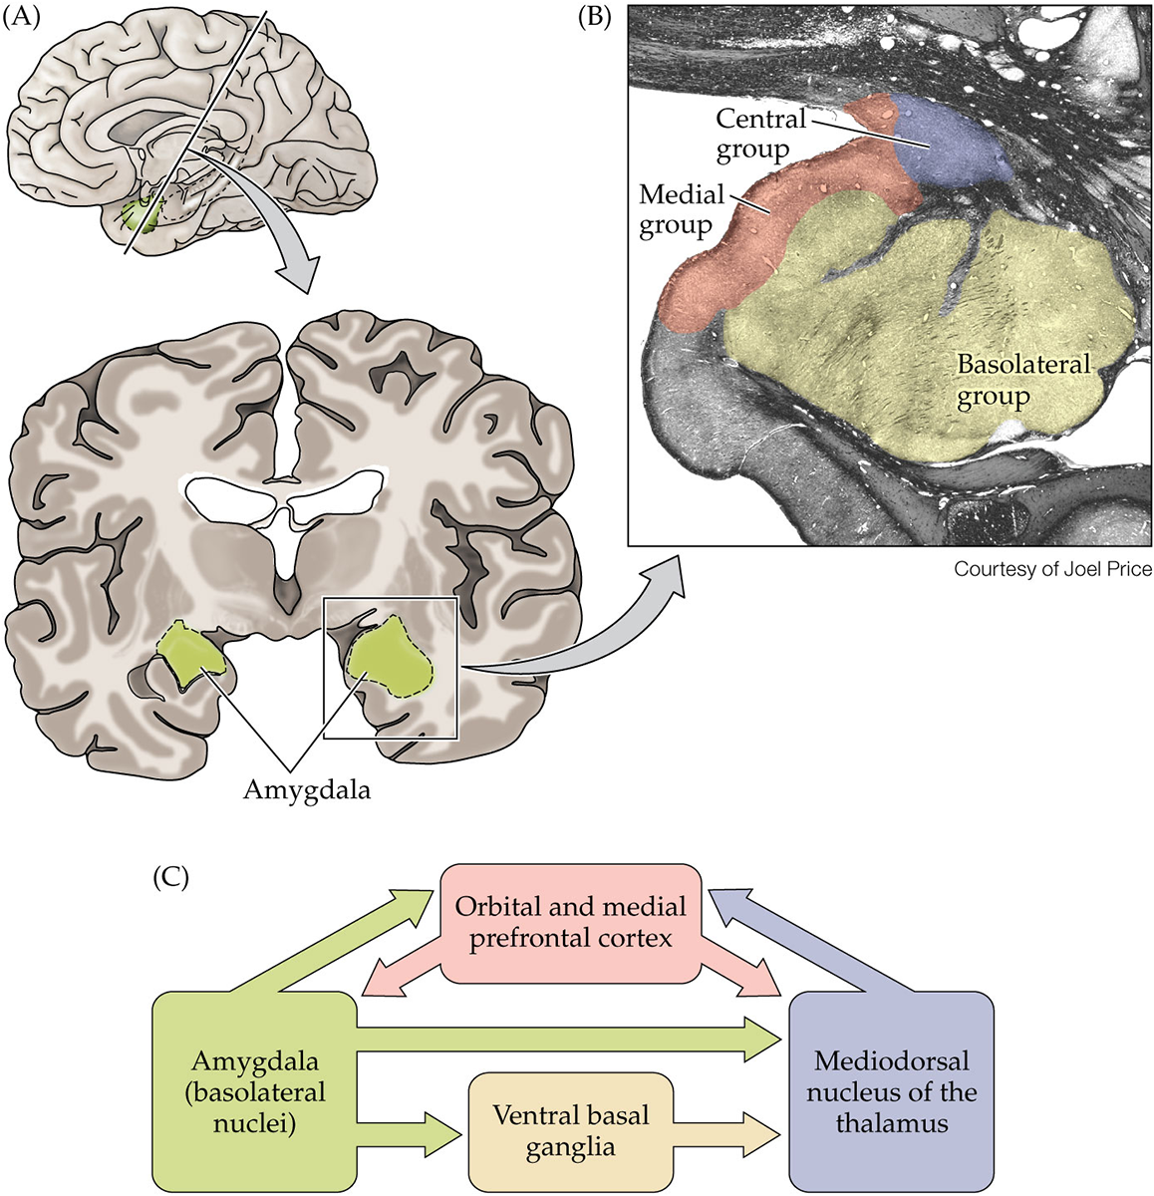
Anatomy of the Amygdala
Groups:
  Central: connected to hypothalamus and brainstem
  Medial: connected to olfactory areas
  Basolateral: connected to cortical areas
The amygdala is important in determining the emotional significance of sensory stimuli

Slide 6
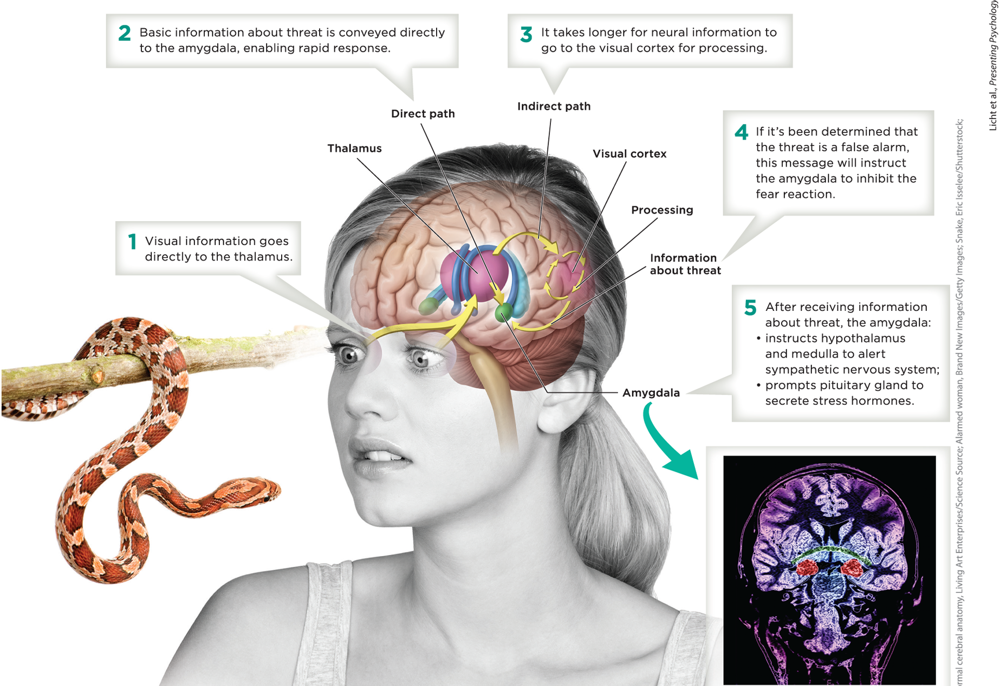
Pathways to the Amygdala and Fear/aggression
Direct pathway (Low road): sensory information from the thalamus that goes directly to the amygdala.
  Immediate emotional reactions.
Indirect pathway (High road): information is routed through cortex before being sent to the amygdala.
  Cognitive evaluation of emotion in context.

Slide 7
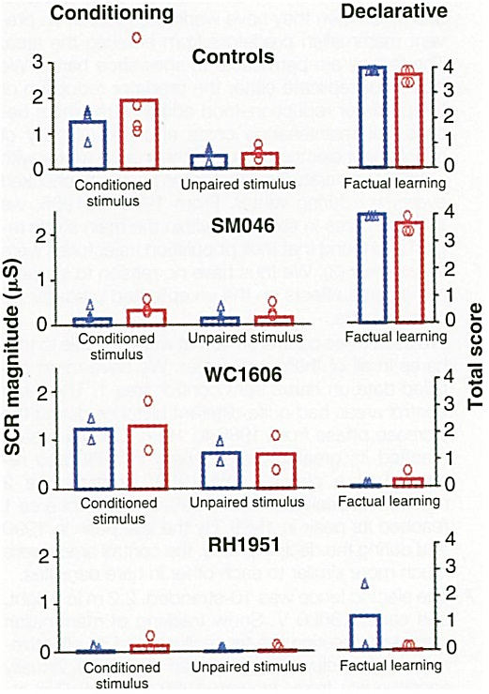
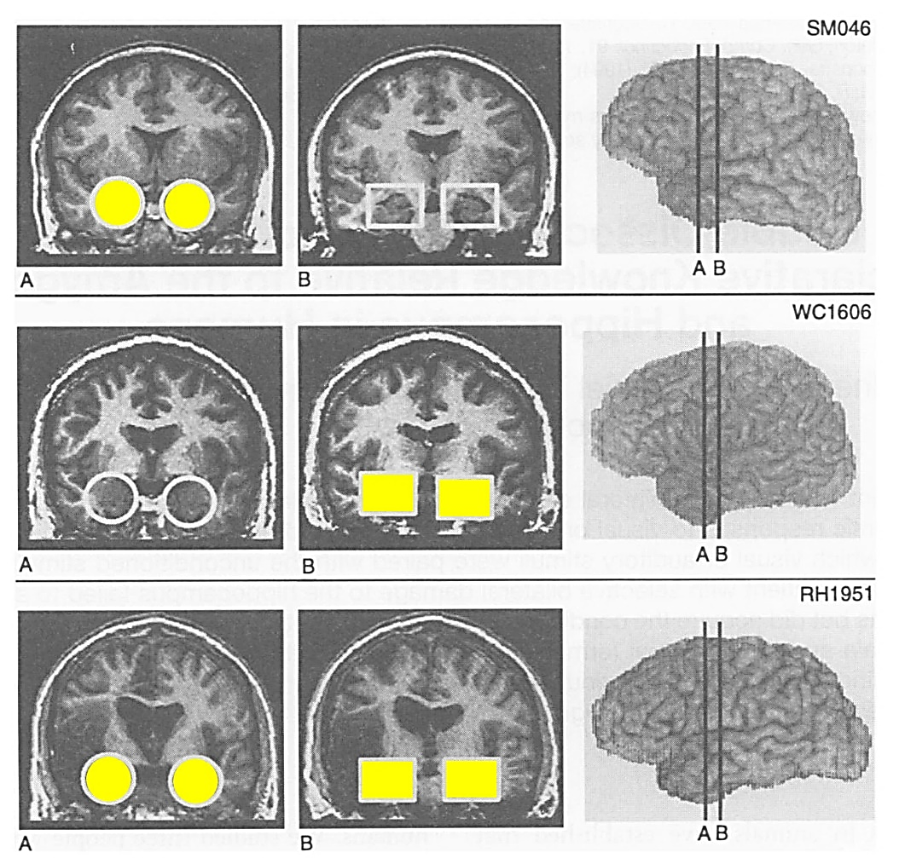
The amygdala and social behavior:
Patient S.M.
Patient S.M. had Urbach-Wiethe disease, which damages both amygdalae.
Patient S.M. experienced:
  Impaired fear conditioning
  History of poor life choices
  Difficulty recognizing facial expression of fear
Amygdala Hippocampus
from Bechara et al. 1995

Slide 8
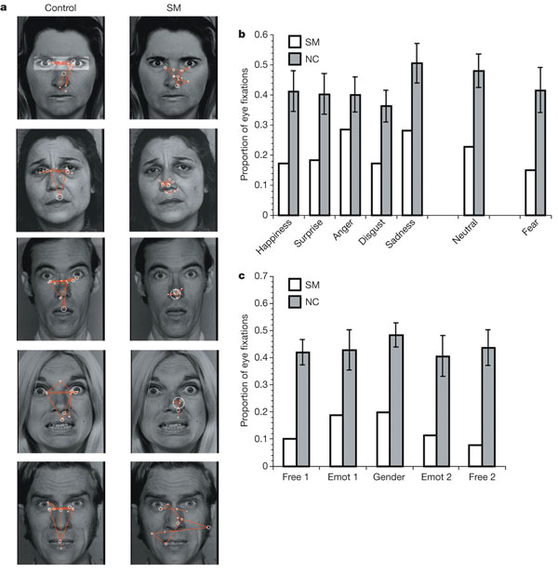
control
SM
Fear
Anger
Sadness
from Adolphs et al. 2005

Slide 9
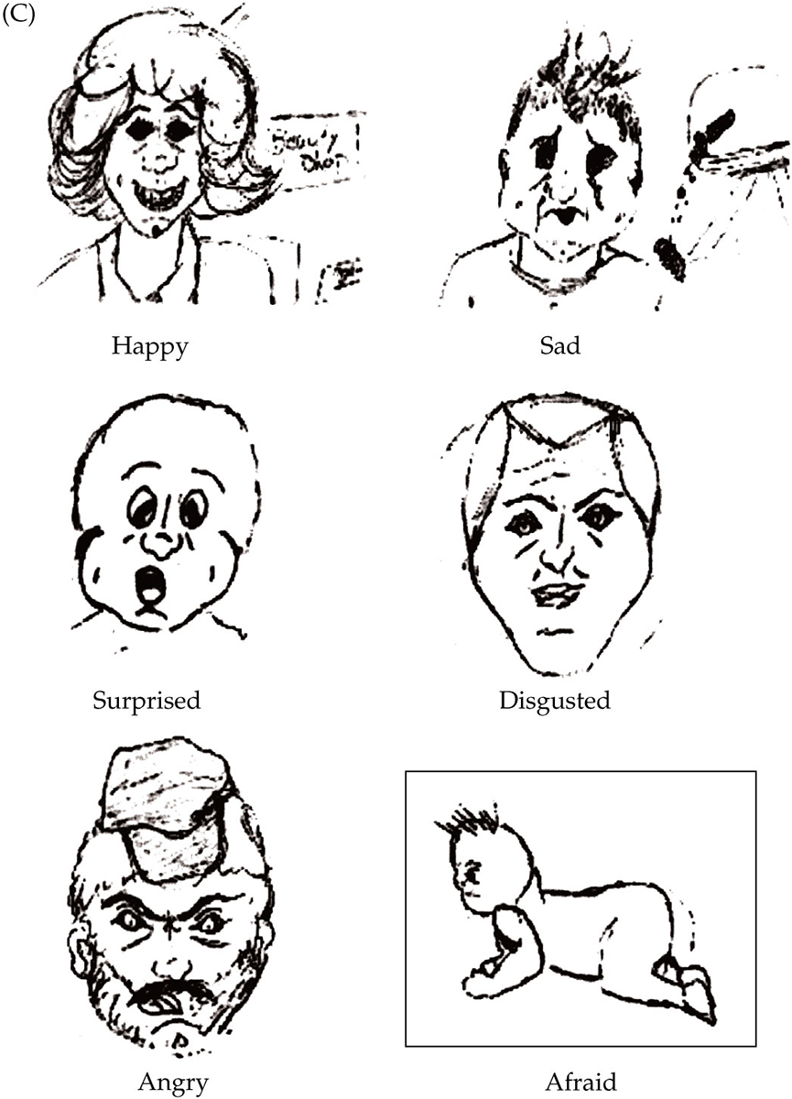
S.M.’s Drawings of facial expressions of emotion

Slide 10
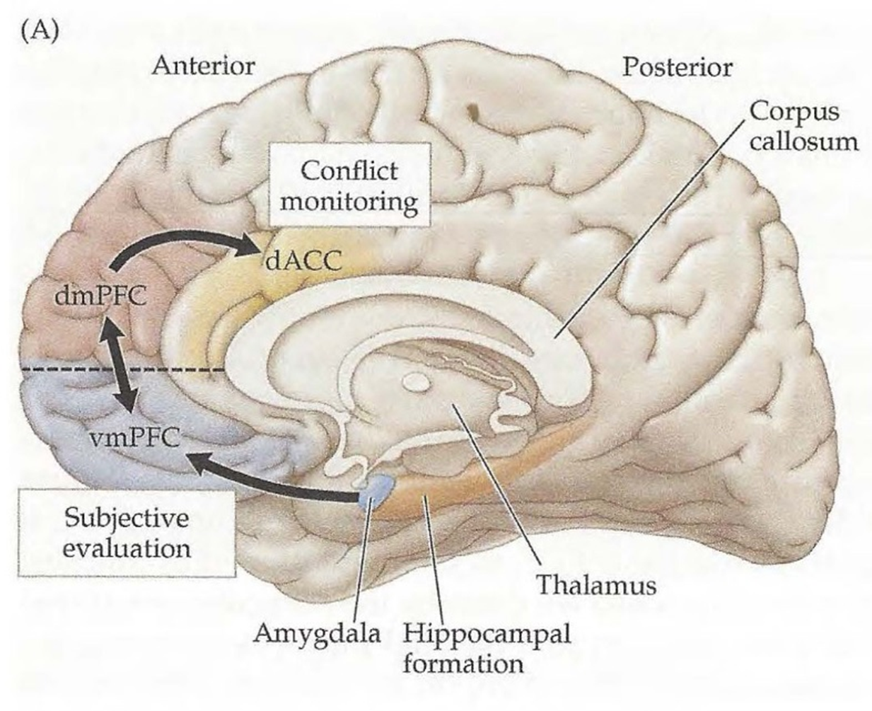
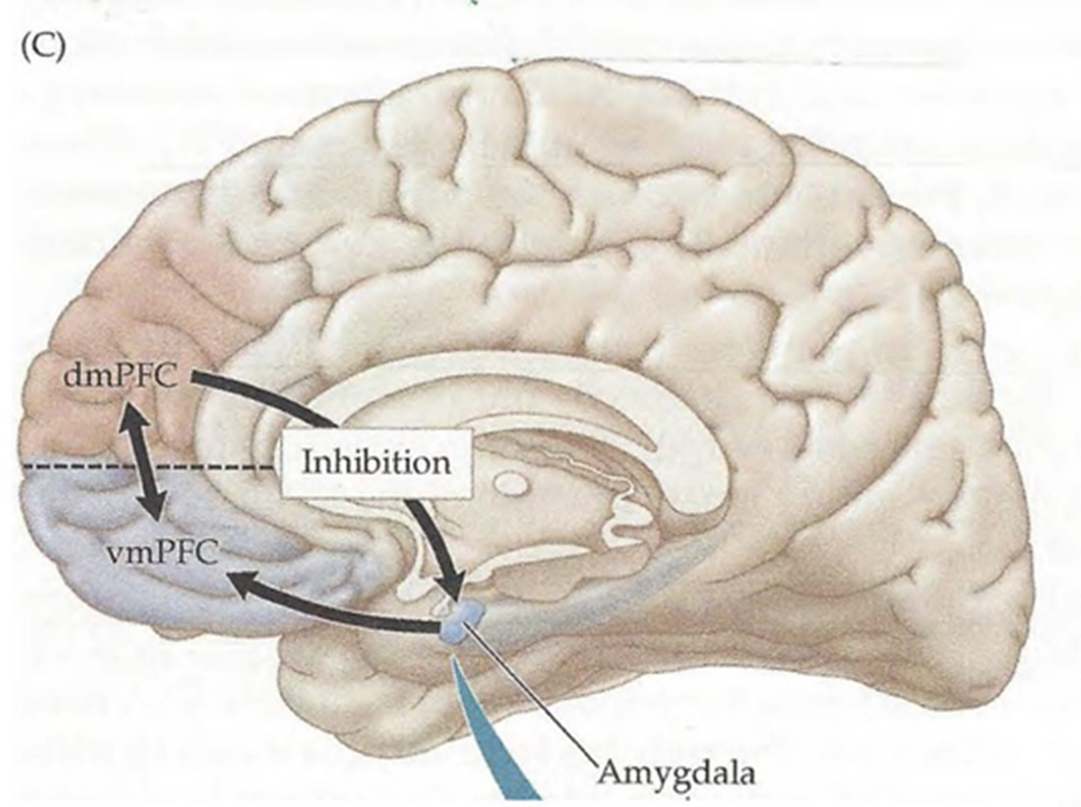
The amygdala has extensive reciprocal connections with the PFC
  Multimodal (including emotional) inputs are evaluated and integrated by the PFC
    Internal, subjective experience (“feeling”)
    Top-down (descending) control to terminate amygdala output
      Extinction of conditioned fear

Slide 11
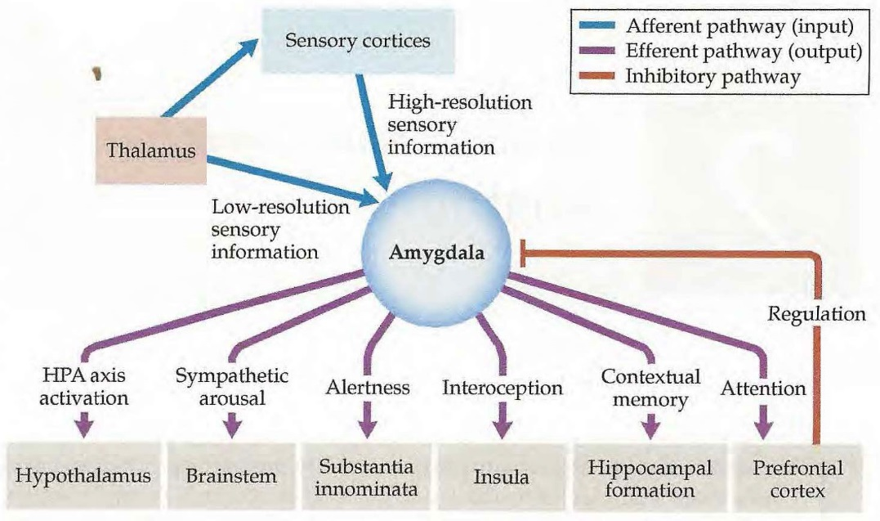
The PFC and the corticolimbic circuit
The PFC is necessary for restoring the normal “resting” state when danger has passed
Often dysfunctional in mood related disorders
Top-down inhibition

Slide 12
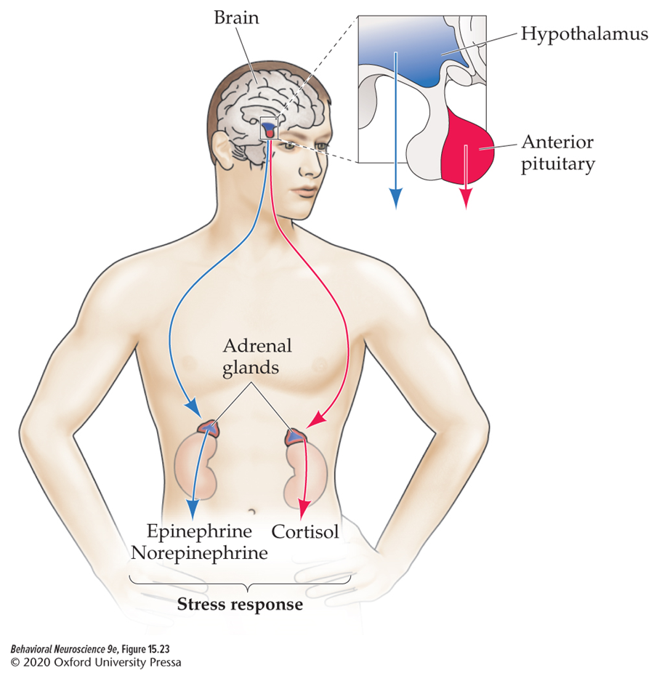
THE HPA Axis responds to stress
Stress is any circumstance that upsets homeostatic balance.
Hypothalamus releases hormones to the anterior pituitary.
The anterior pituitary releases hormones to the adrenal gland.
Adrenal medulla releases epinephrine and norepinephrine.
Adrenal cortex releases steroid hormones (e.g. cortisol).

Slide 13

Lateralization of Emotion in cortex
Right hemisphere:
  Overall perception and expression of emotion
  Emotional aspects of language
  Negative emotions
Left hemisphere:
  Positive emotions

